Slide 1
Register API GW By Swagger File Guide

Slide 2
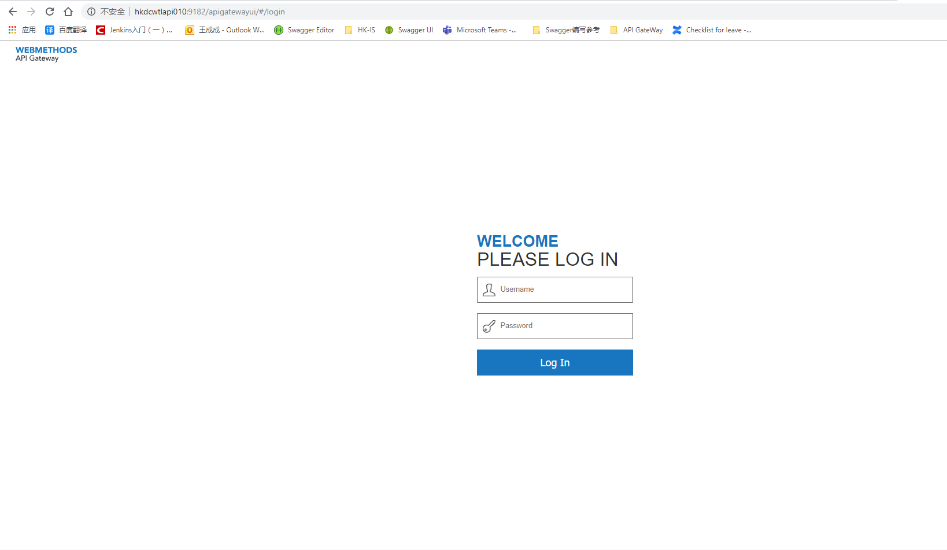
Login API GateWay
http://hkdcwtlapi010:9182/apigatewayui/#/login
login API
2: enter Lan ID and Password

Slide 3
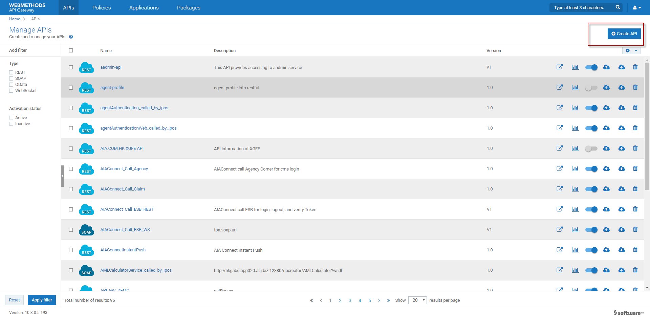
Register API GateWay
Click create API

Slide 4
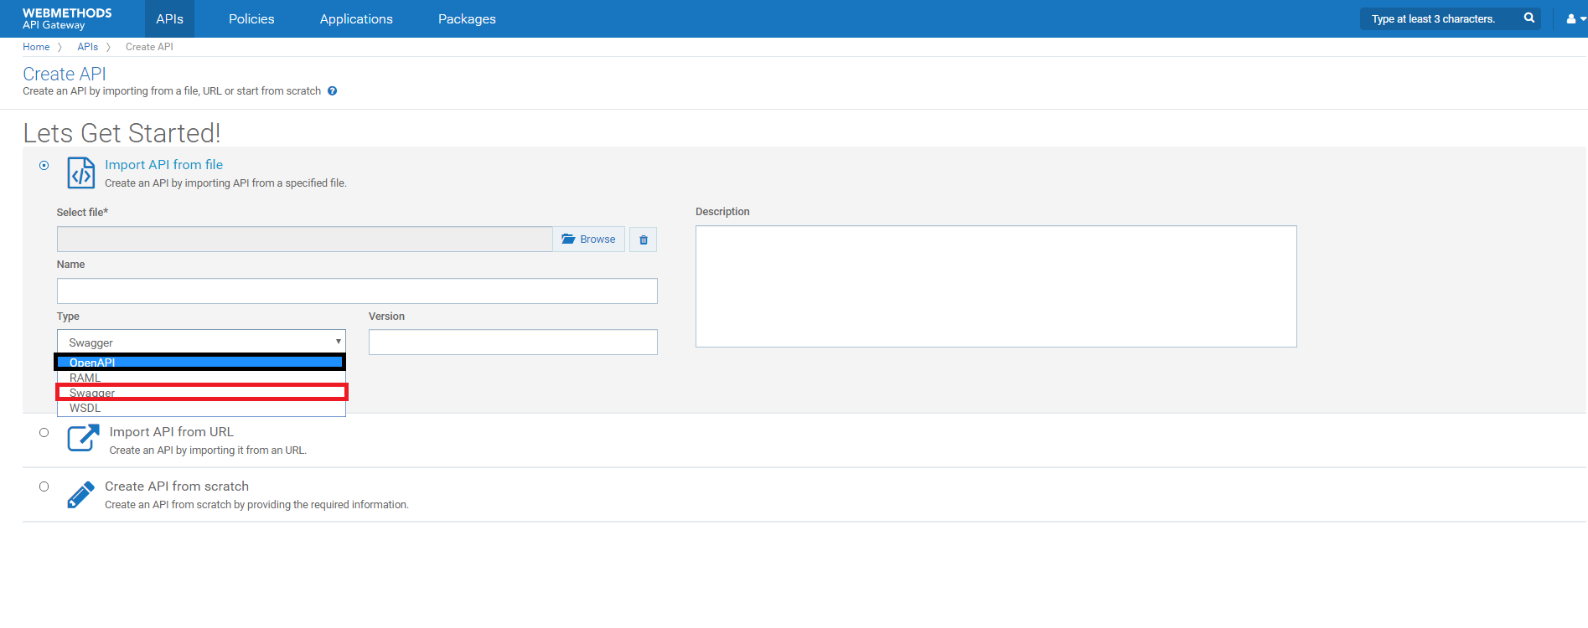
Choose Type
The First step:
If your swagger file is 3.0, you should choose OpenAPI
If your swagger file is 2.0,you should choose Swagger
The second step:
Click Browse choose your swagger file and enter API Name
The third step:
You can choose Version is 1.0(Currently in use)
Next:
Add Description

Slide 5
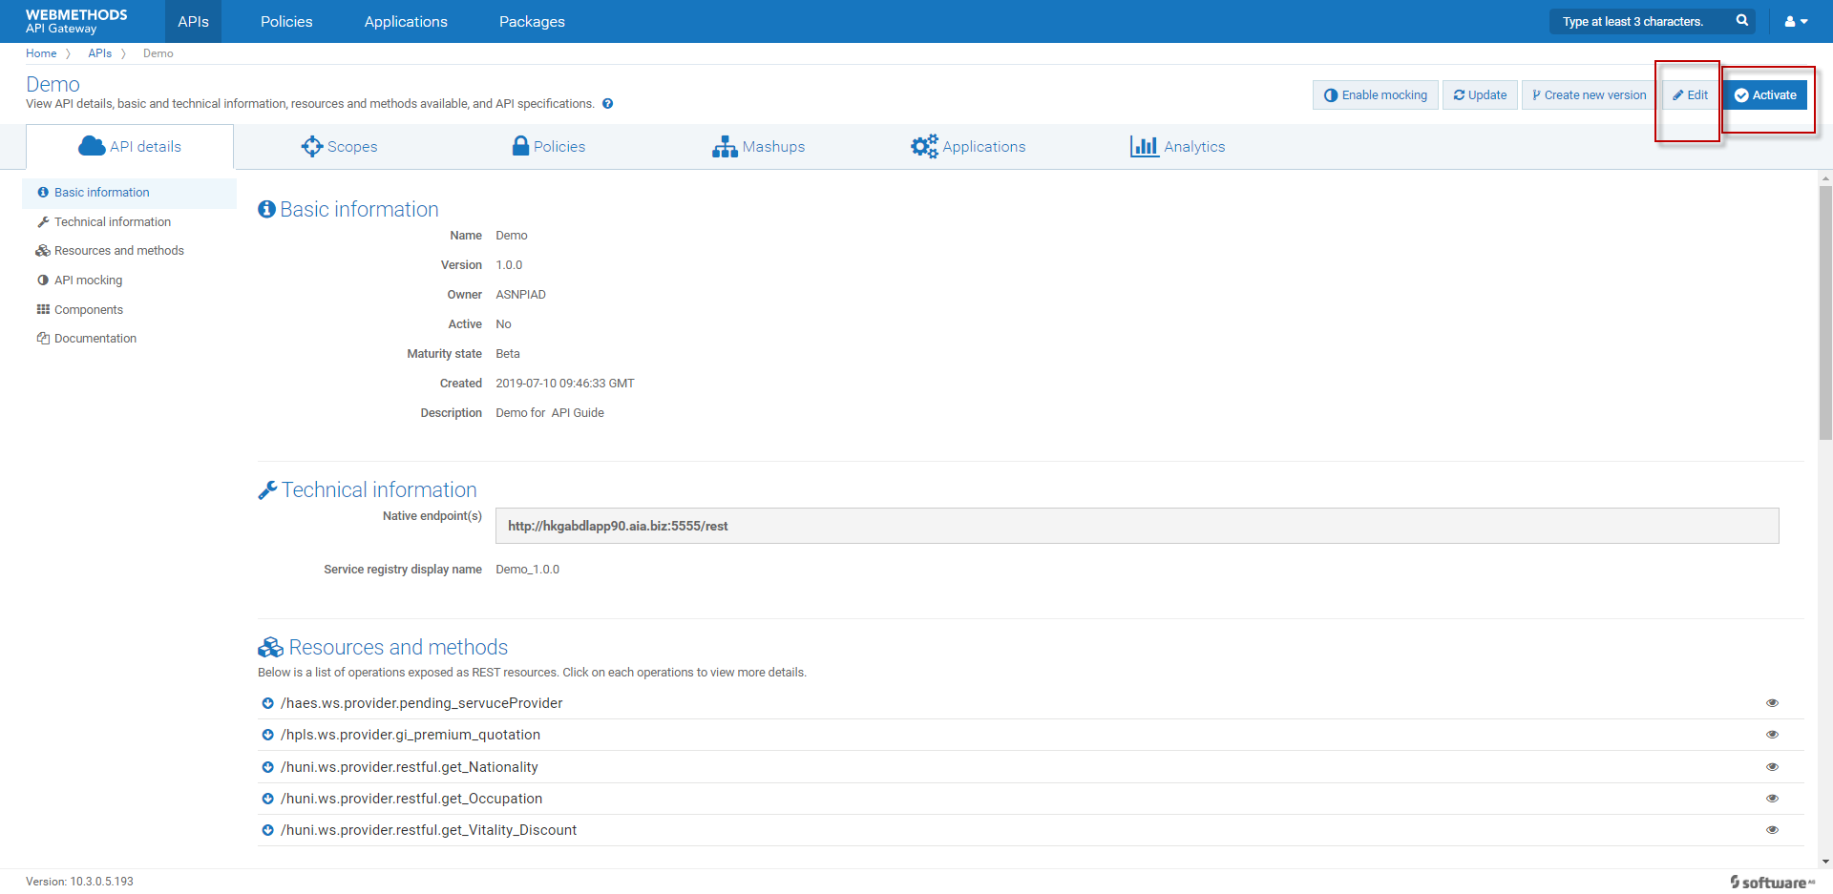
Edit API
1 Choose Policies
2 Click Edit button

Slide 6
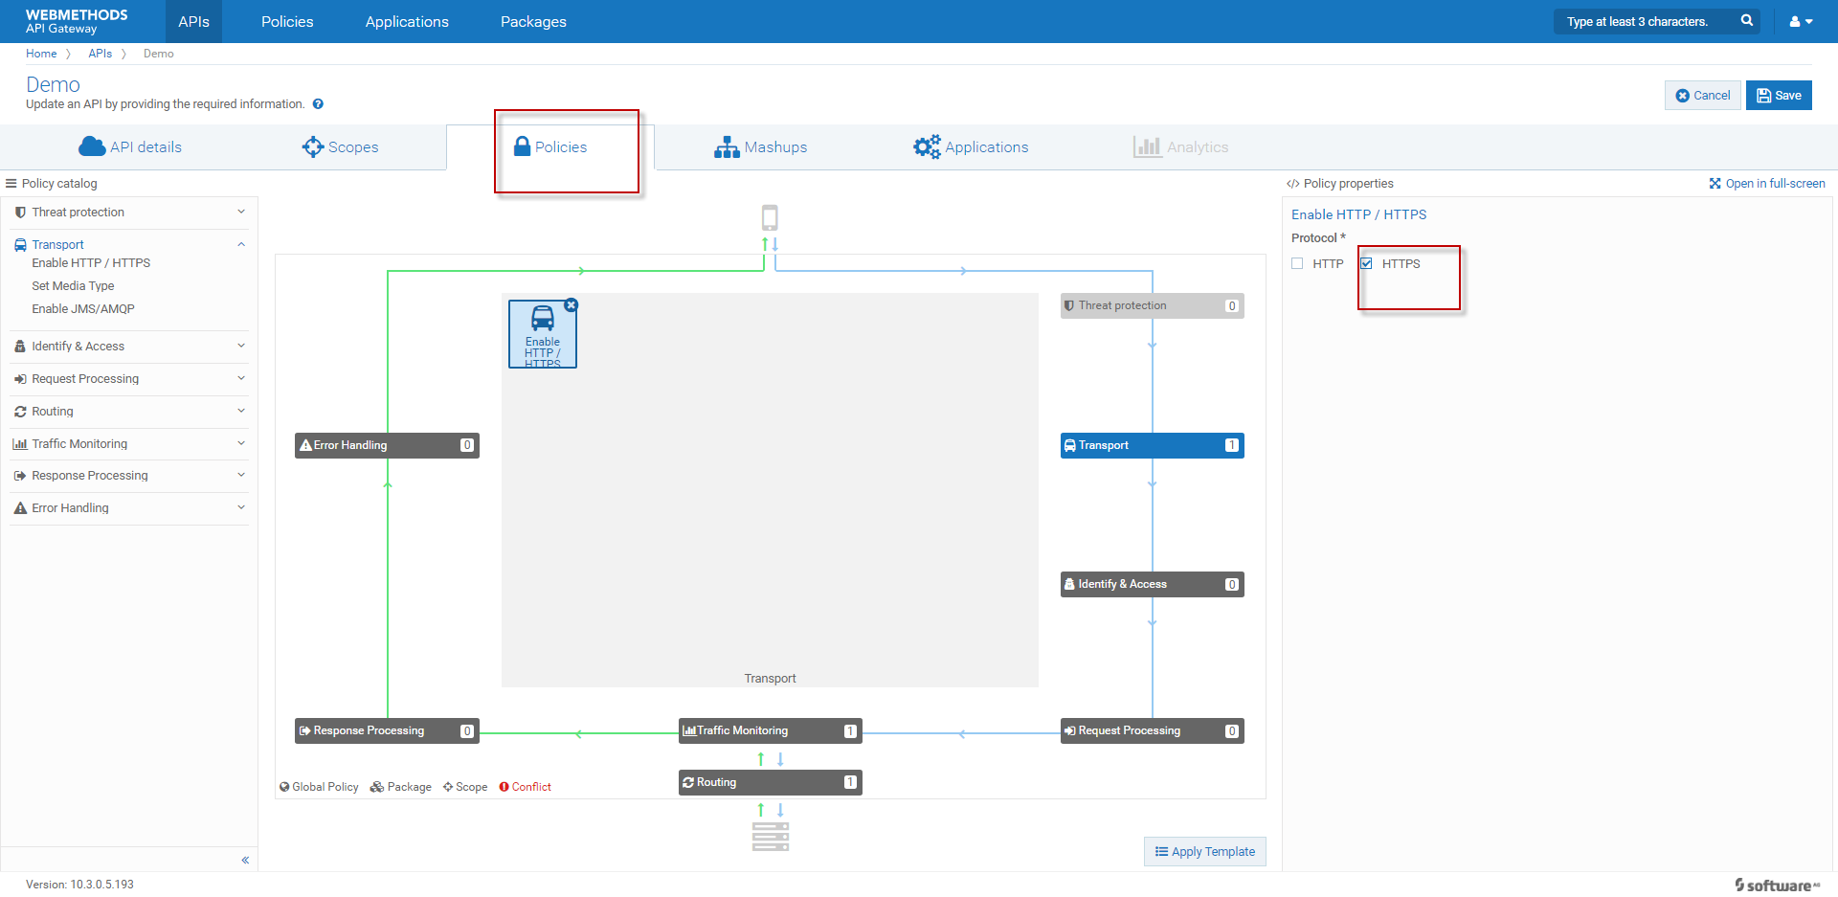
Edit Policies
1: click Policies
2: click Edit
3: click Transport
4: choose Protocol

Slide 7
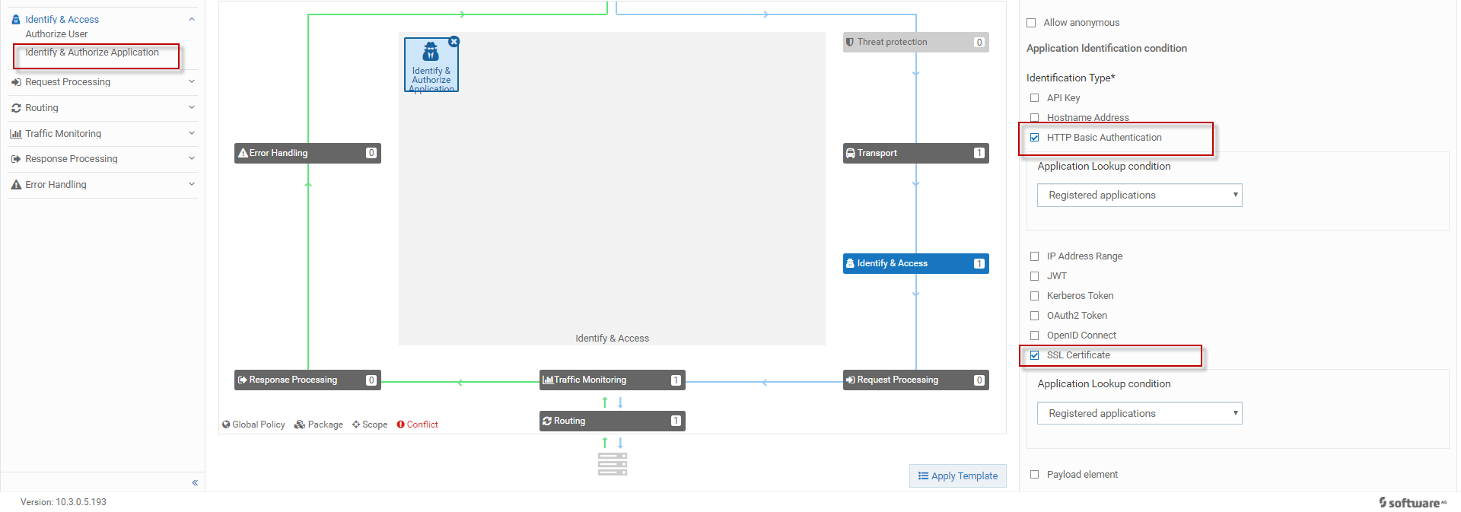
Edit Identify&Access
1: Click Identify&Access
2: Choose Identify&Authorize Application
3: Choose Http Basic Authentication
4: Choose SSL Certificate(if you need)

Slide 8
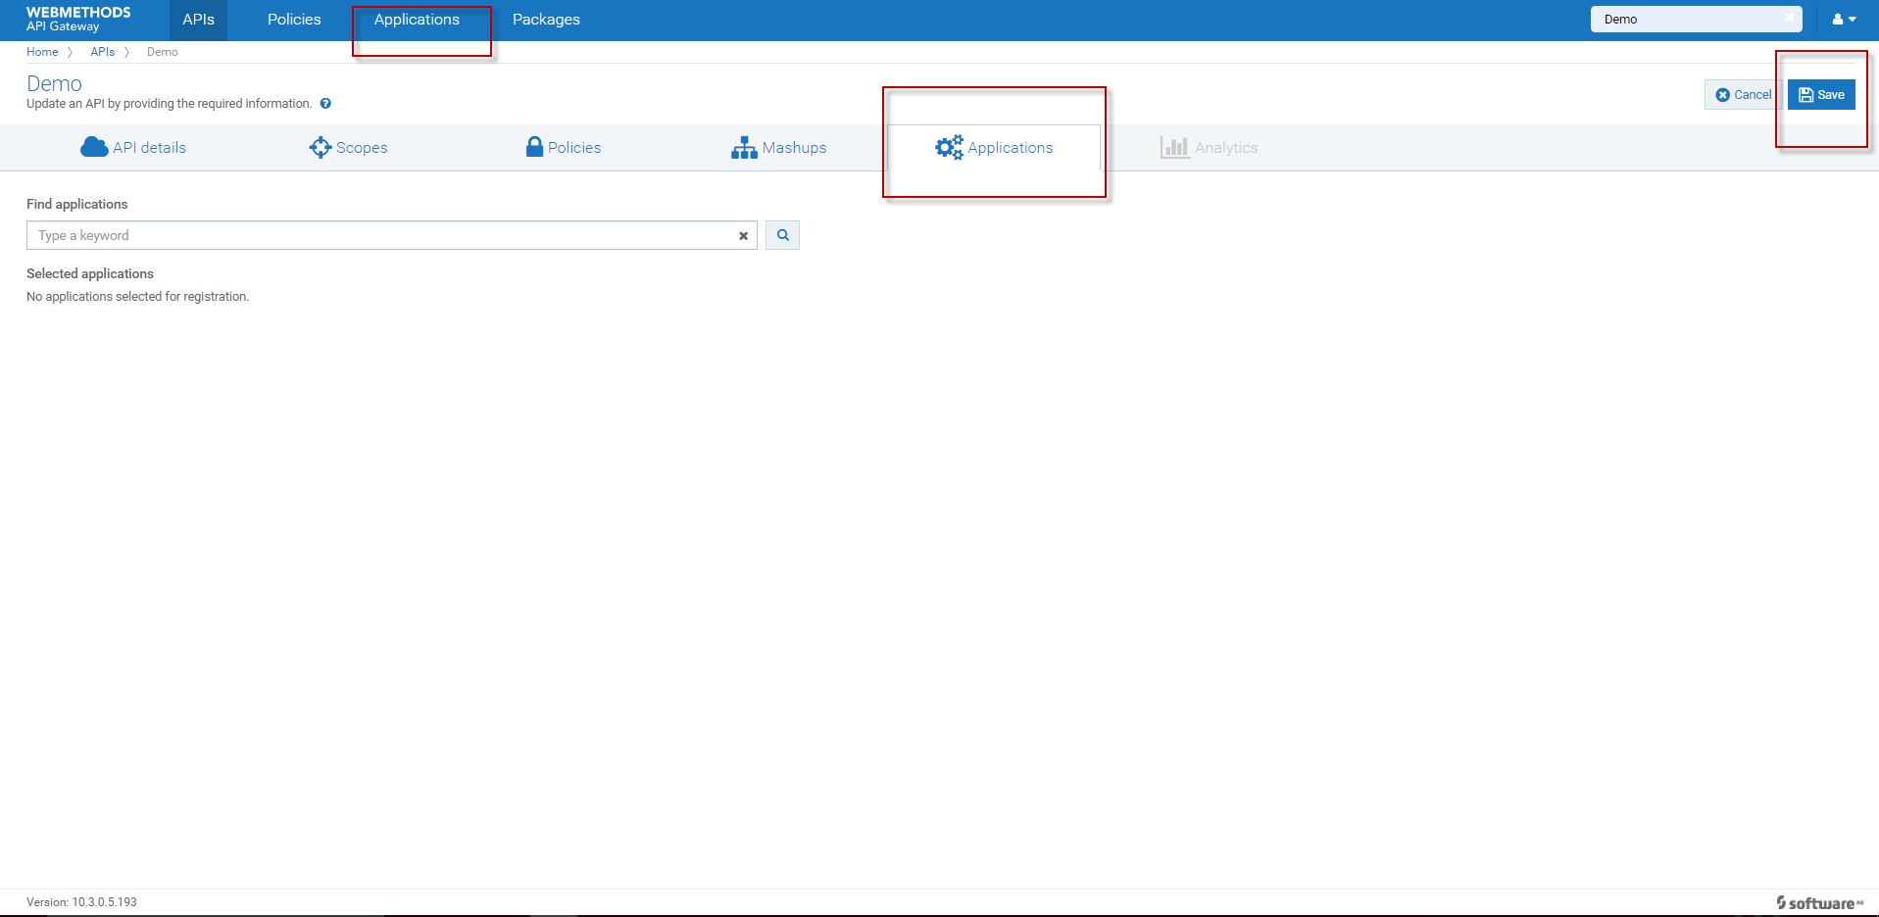
Choose Application
1: Click Applications
2: If you did not created Application Please go next step
3: Click Save
4: Click Applications and create Application for your API

Slide 9
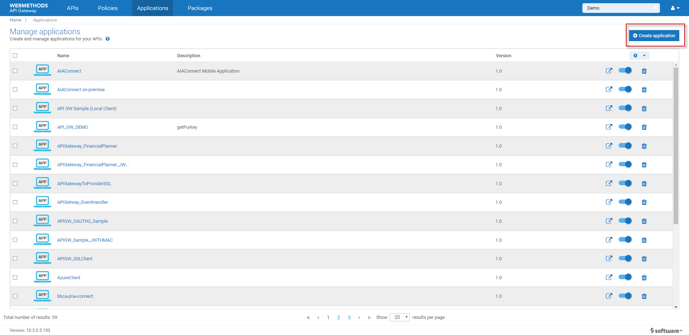
Create application

Slide 10
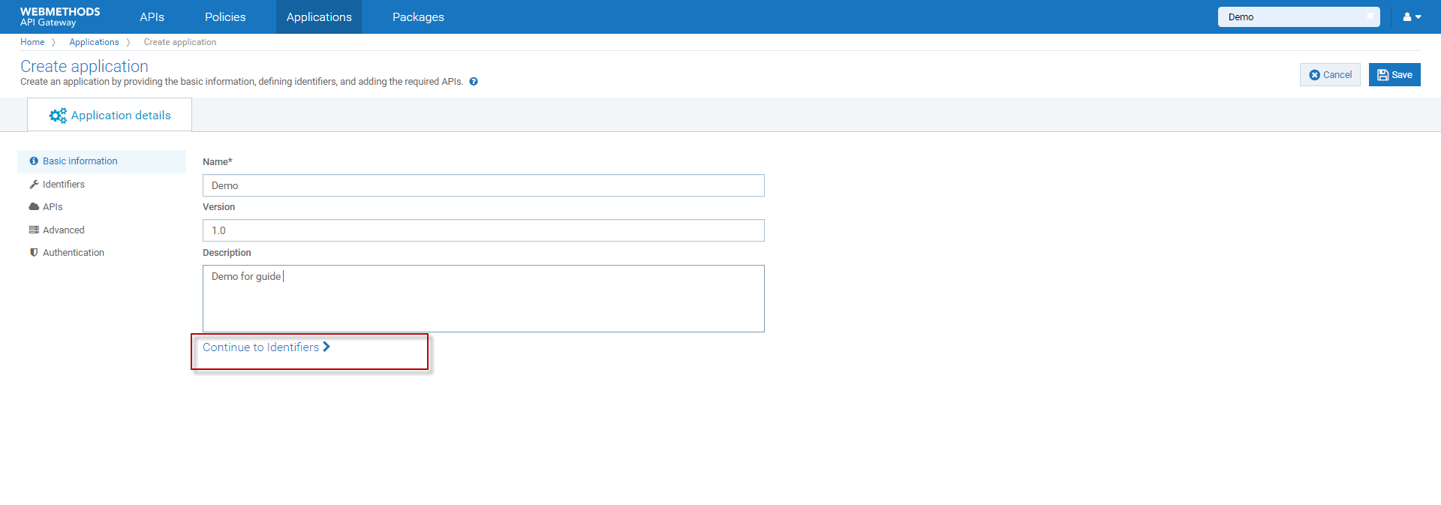
Edit Application
1: Enter Application Name
2: Add Description
3: Click Continue to Identifiers

Slide 11
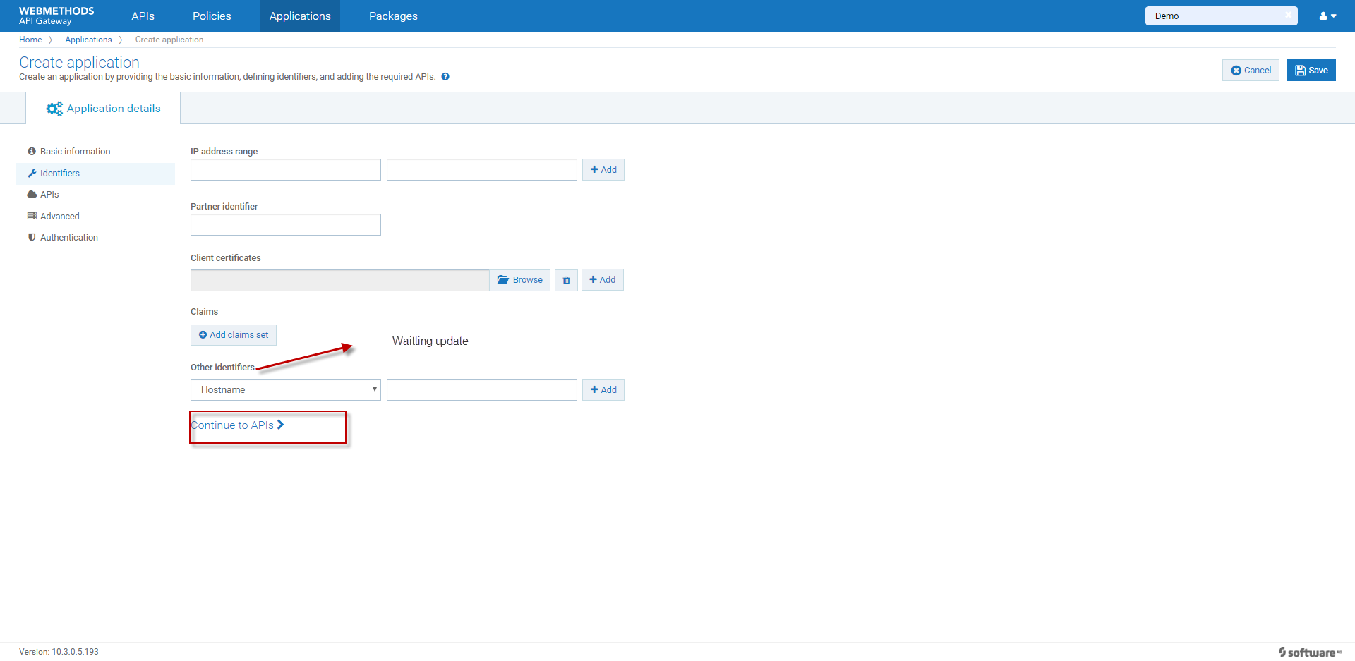
Edit Identifiers
1: Click Continue to APIS

Slide 12
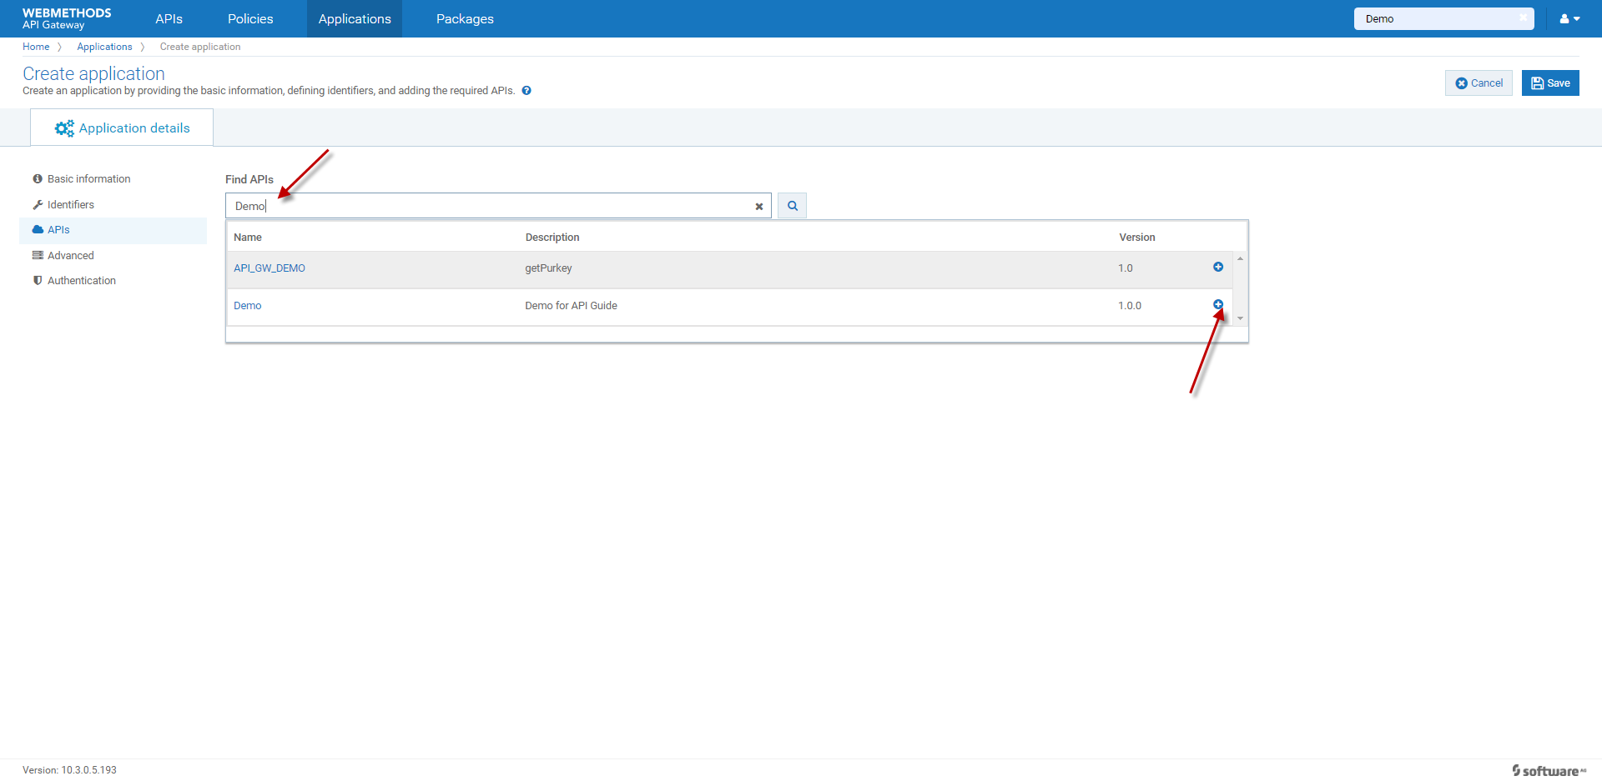
Choose APIS
1: Enter you have created API Name
2: Click + to Add API
3: Click Continue to Advanced

Slide 13
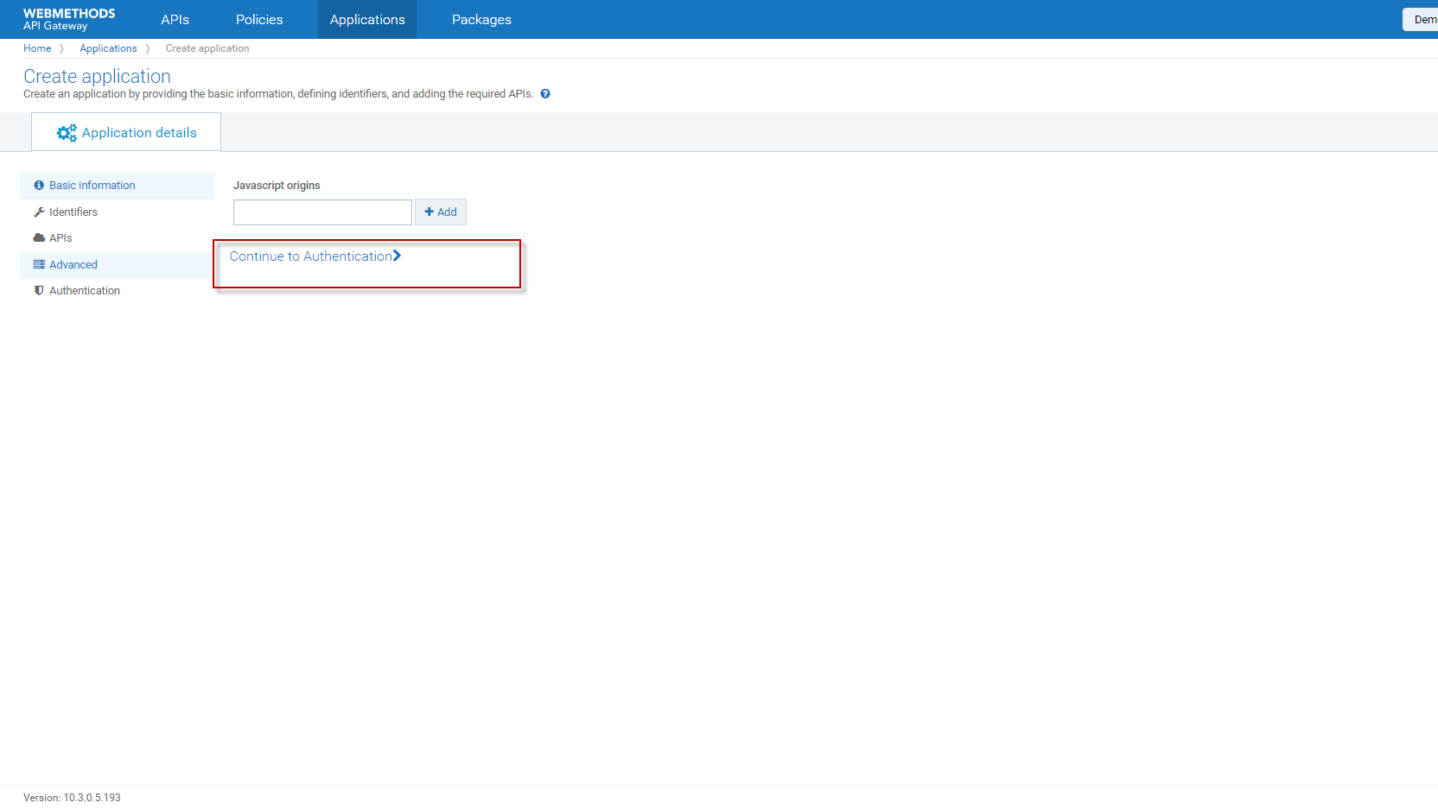
Edit Advanced
Click Continue to Authentication

Slide 14
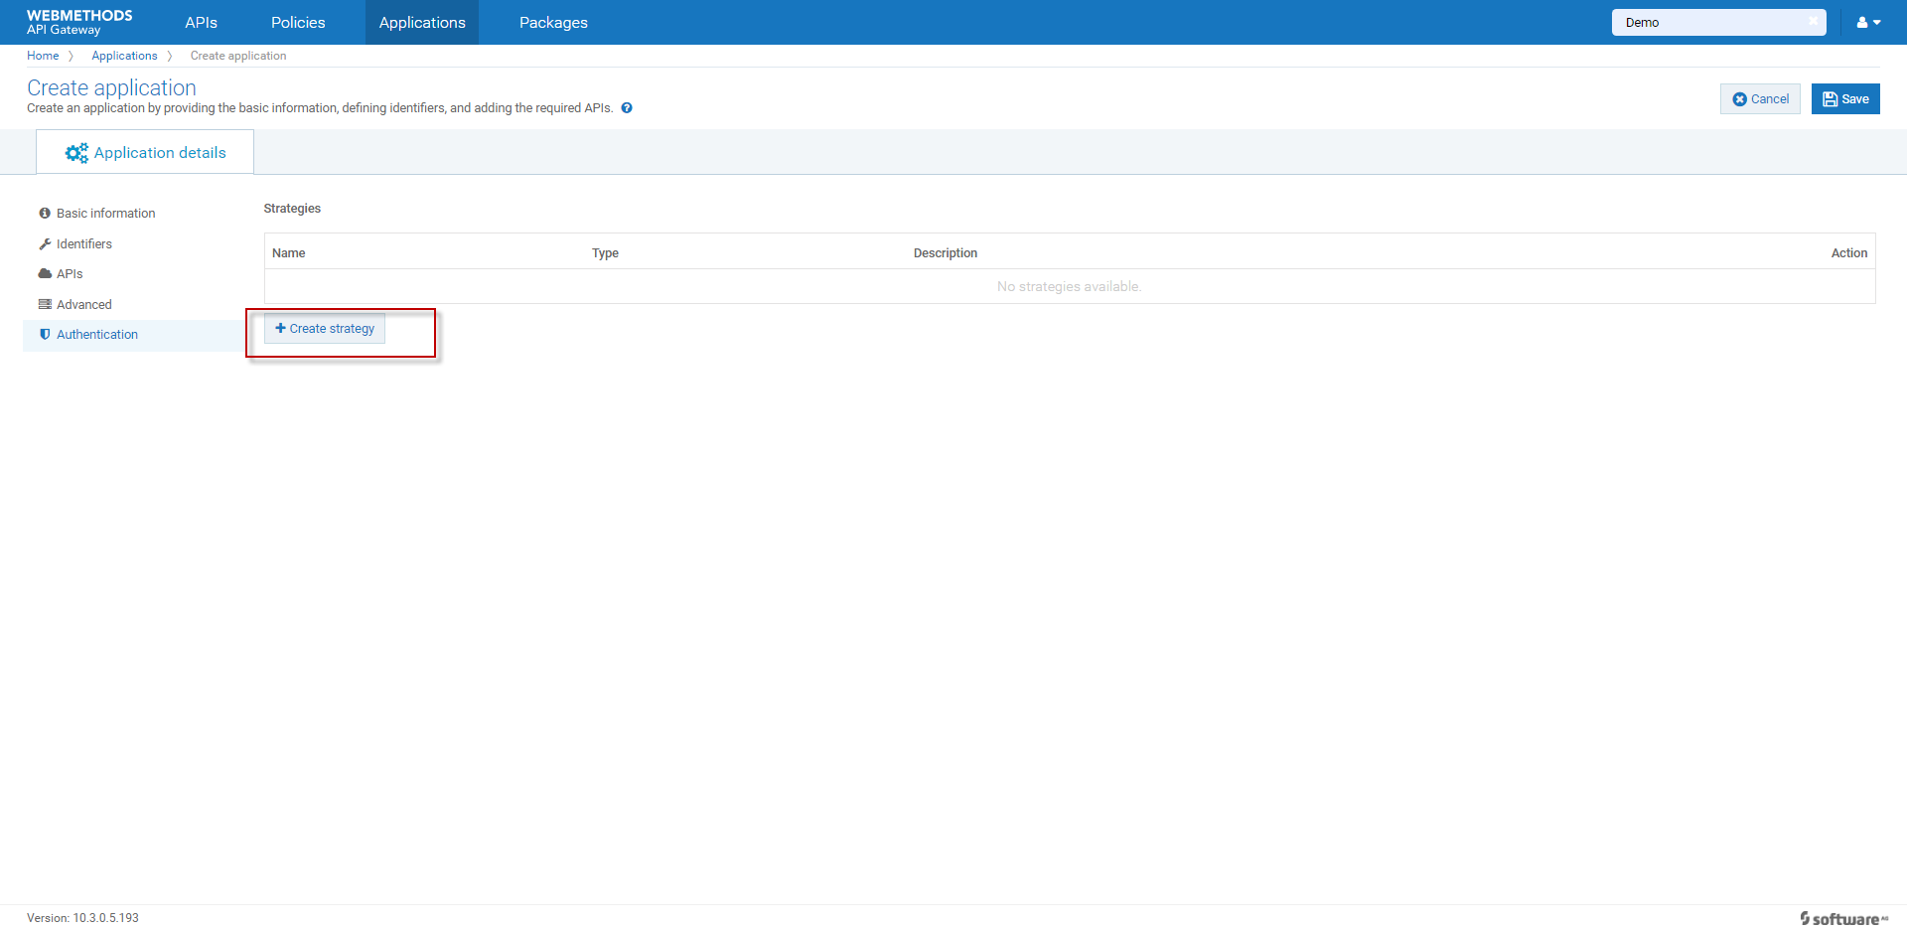
Edit Authentication
Click Create strategy

Slide 15
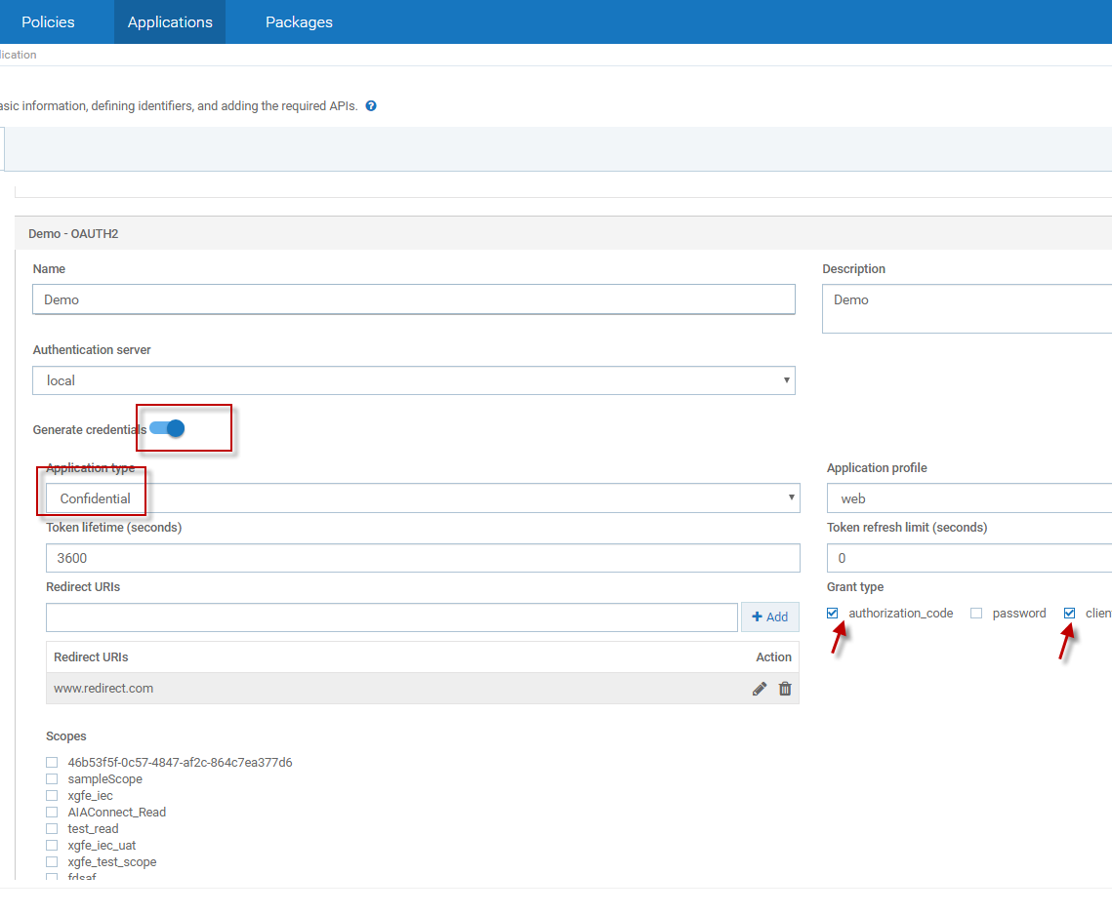
Edit Authentication
1: Add Name and Description
2: Open Generate credentials
3: Click Application type--→Confidential
4: Enter Redirect URLS and click +Add button
5: Choose Grant type Authorization_code and client_credentials
6: Finally click Add

Slide 16
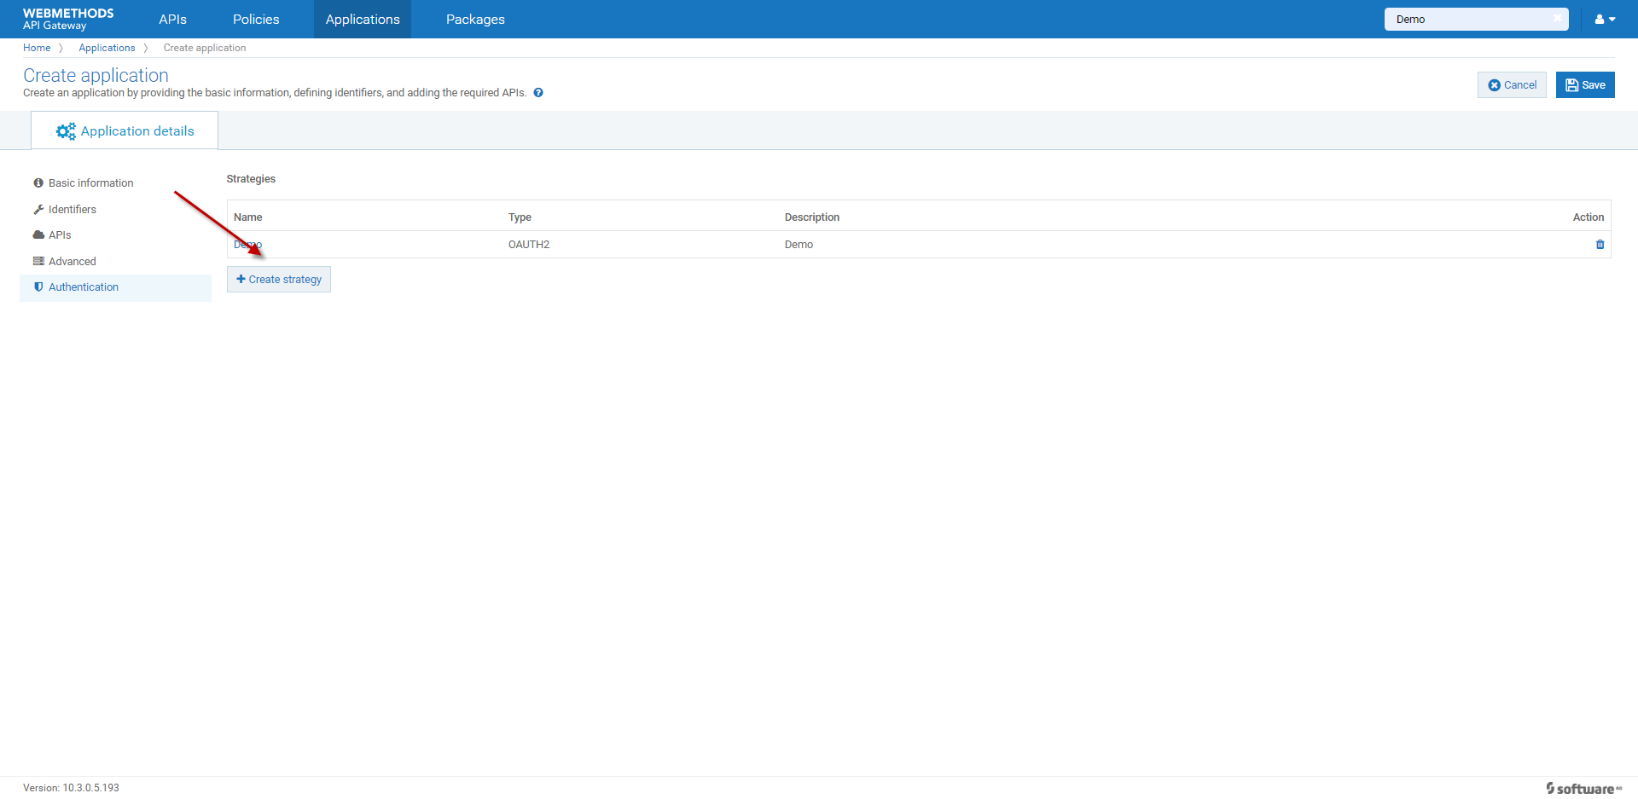
Click
Save

Slide 17
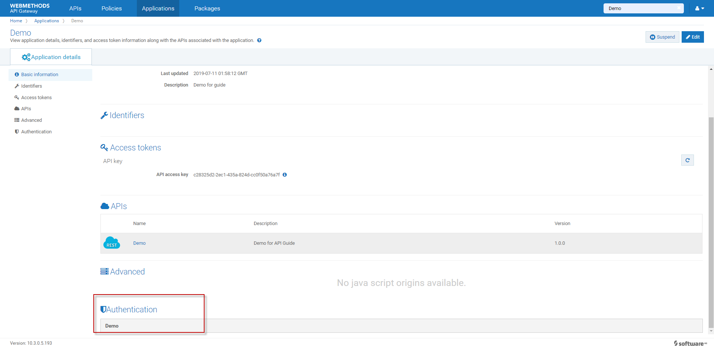
Authentication
Click Demo
And Sliding Mouse roller

Slide 18
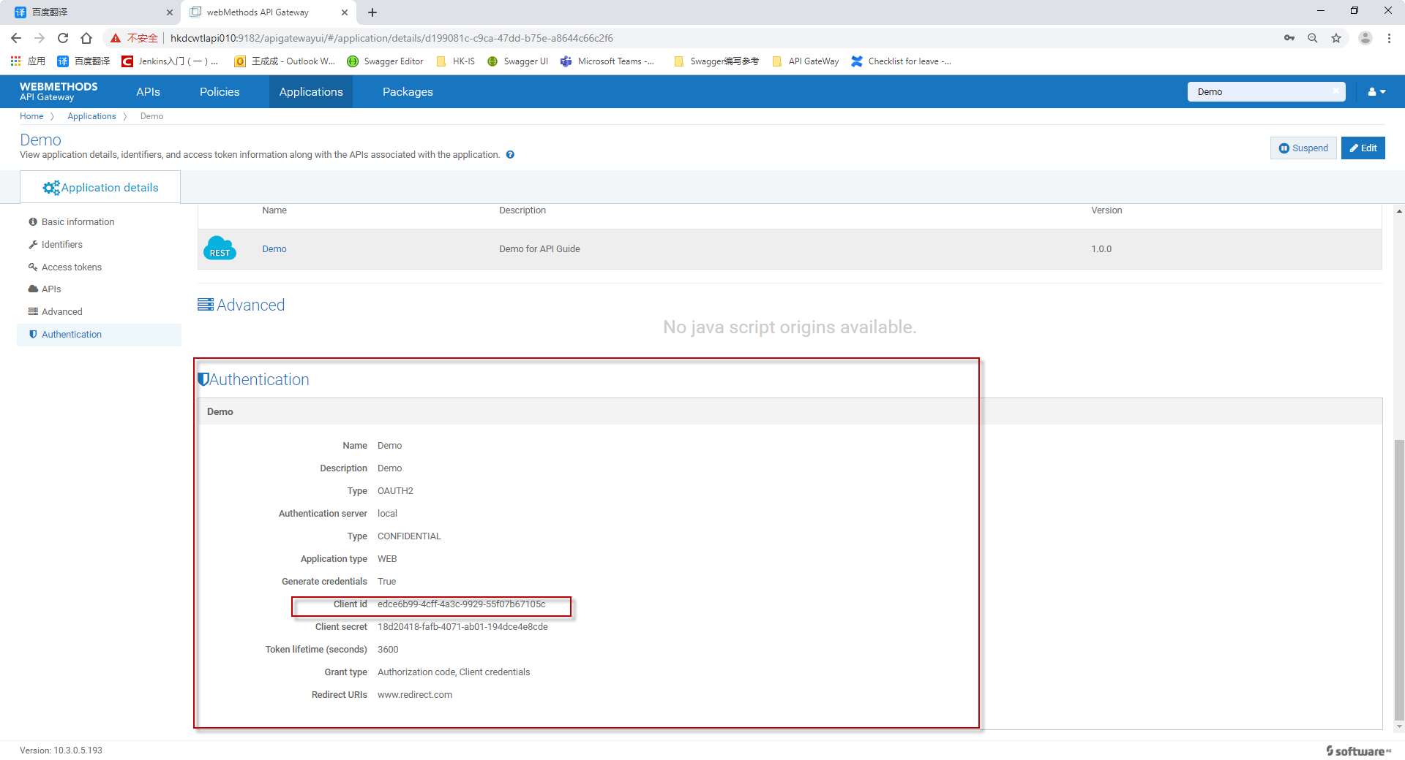
Edit Authentication
1:Copy Client id and secret(use to Basic Auth)
2:Click Edit
3: Choose Identifiers

Slide 19
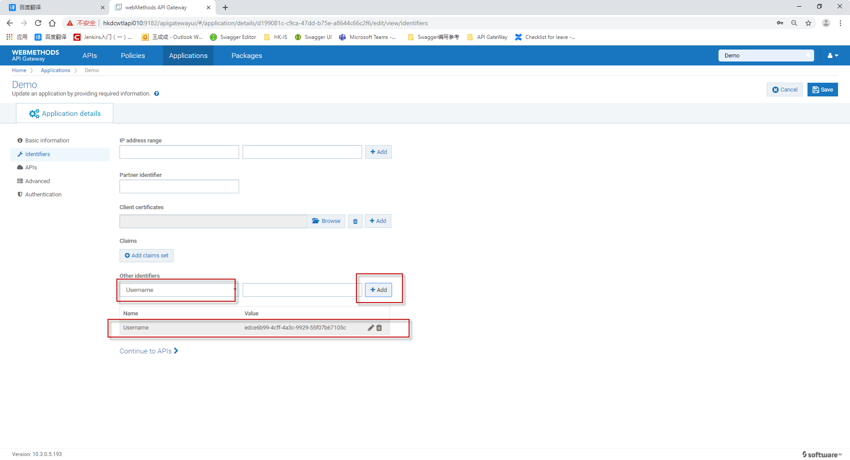
1:Choose other identifiers-→Username
2: paste your client id that you have copied
3: Click add
4: Click save

Slide 20
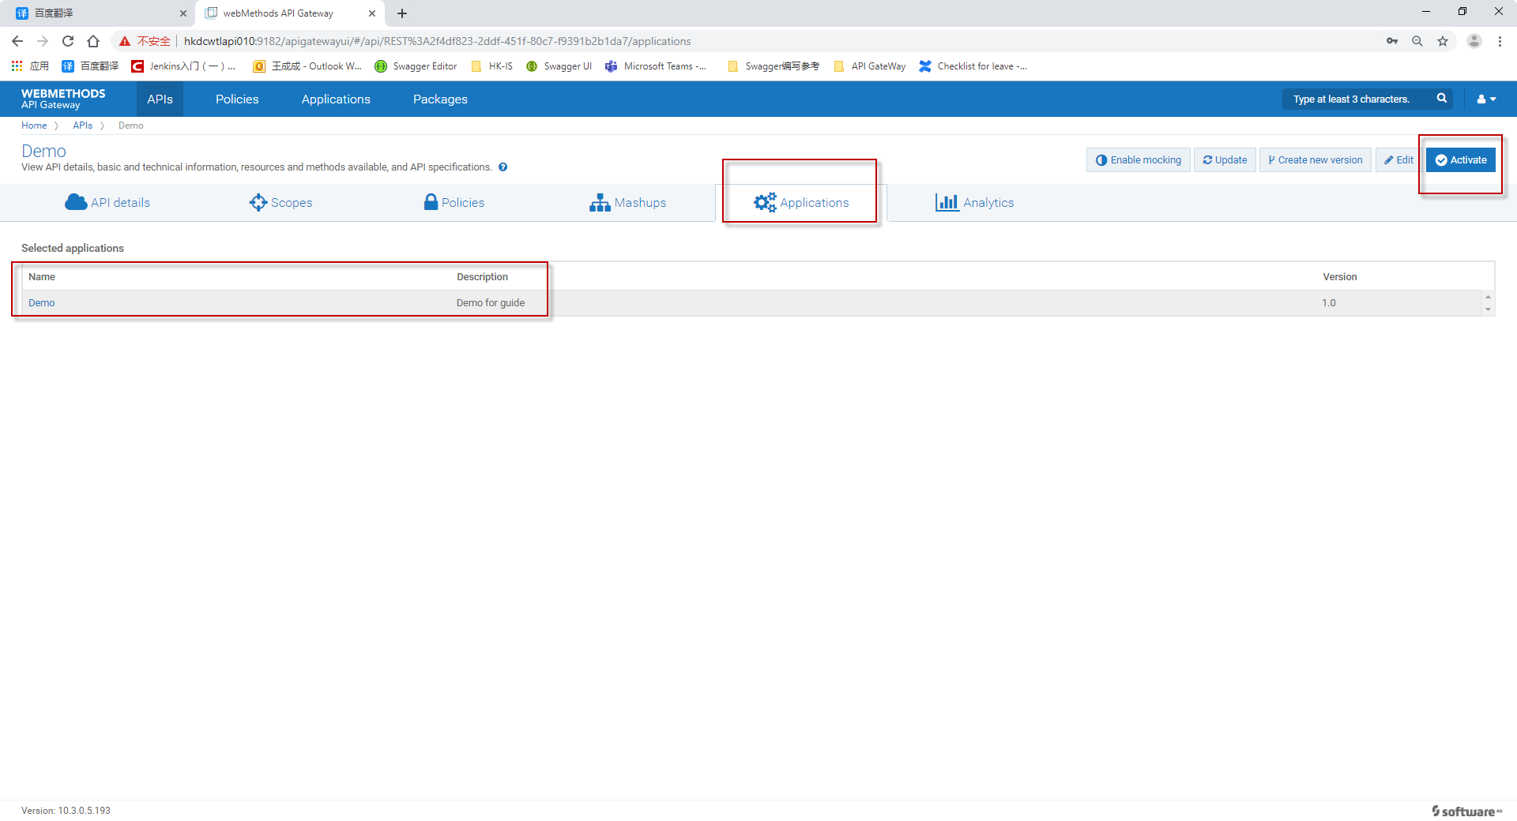
Active your API
1:Click APIs and find you have created API
2: Click Applications
3:Ensure existed Applicaions
4:Click Active and choose yes

Slide 21
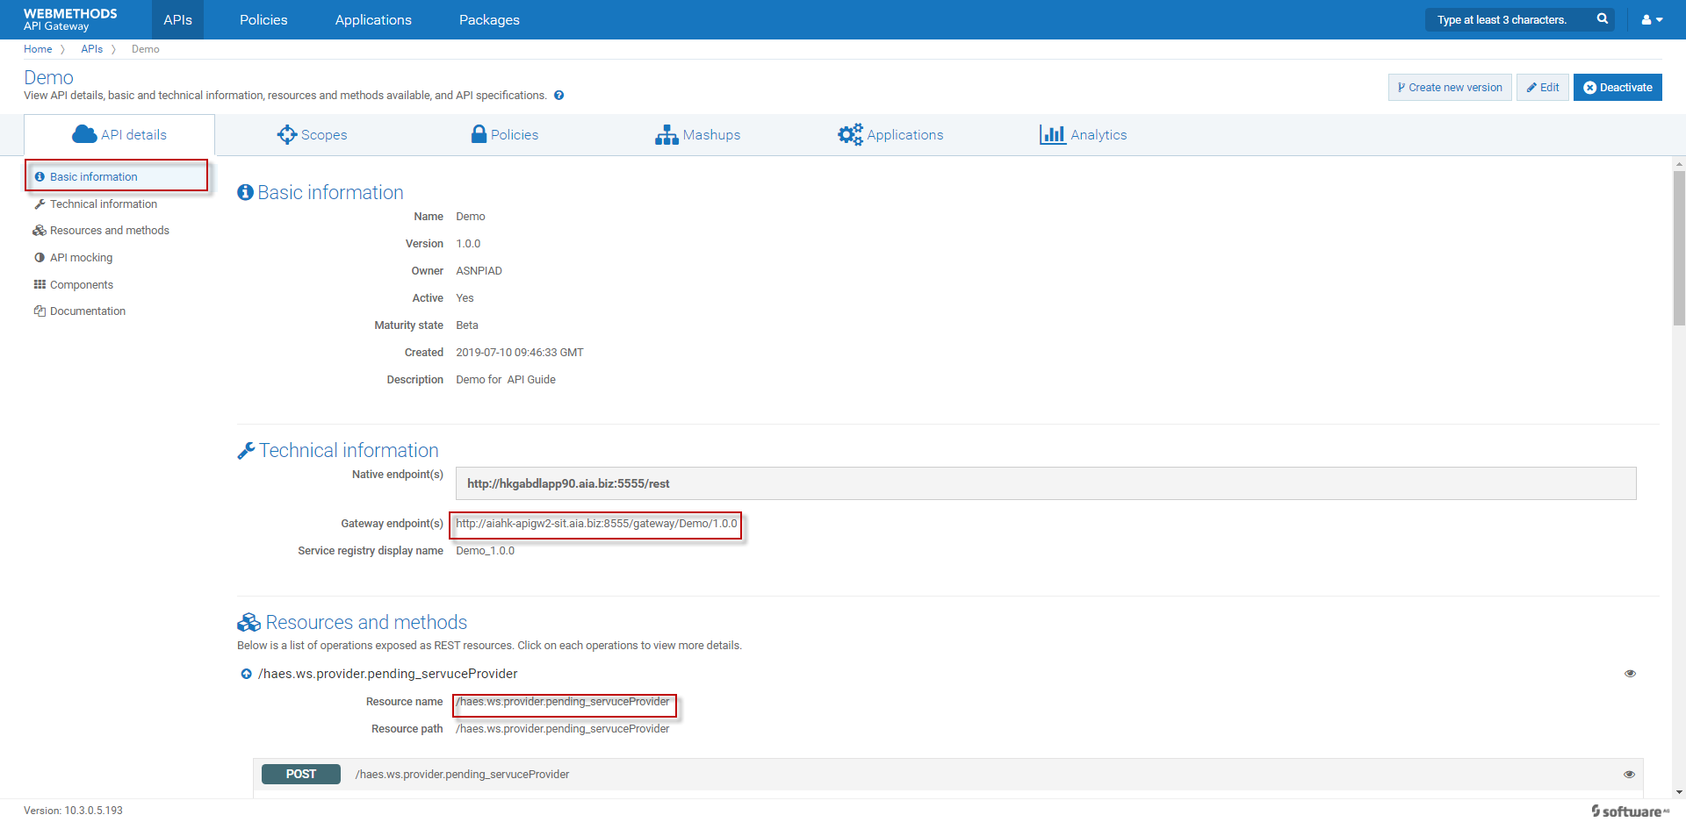
1:Click API details
2: Copy Gateway endpoint(s)
3:Copy Resources name
4: Use postman to test API

Slide 22

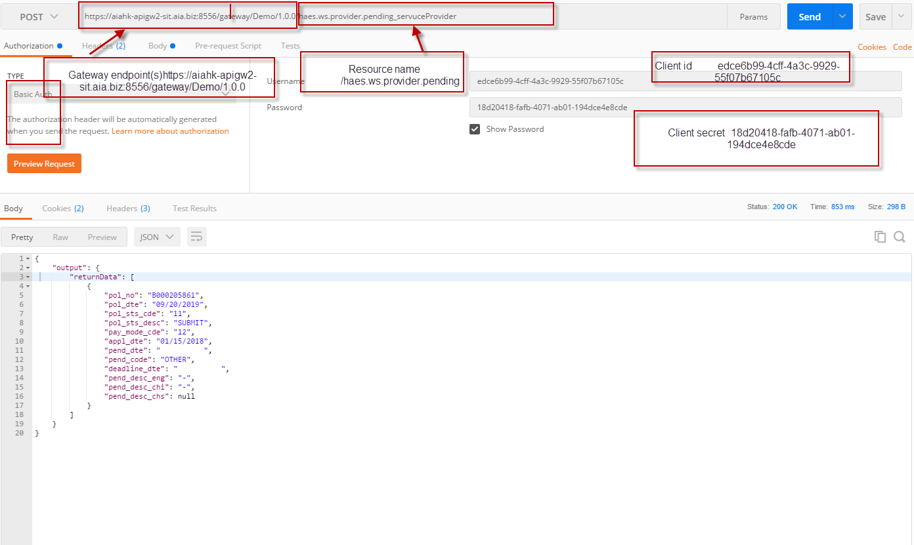
Test API

Slide 23
Thanks

